Slide 1


HS 2015
Current Trends in Distributed Systems
Apache Storm
Group:
Patrick Zumsteg
Simon Wallny
Philipp Oldenburg

Slide 2
Contents
Basics
Applications
Demo
HS 2015
Current Trends in Distributed Systems – Project Idea

Slide 3



Simple Topology
HS 2015
Current Trends in Distributed Systems – Project Idea

Slide 4
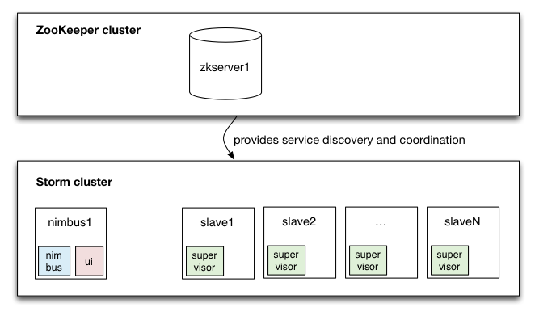
Basics of storm cluster
HS 2015
Current Trends in Distributed Systems – Project Idea

Slide 5
Problem
First we wanted to use it for our project, but...
Can't assign Bolts/Spouts to specific devices
  Client gets rigestered at Nimbus without specifications
  >Every Client has to be able to do every job
HS 2015
Current Trends in Distributed Systems – Project Idea

Slide 6

Solution
Storm Cluster
S1
S2
Server
S3
HS 2015
Current Trends in Distributed Systems – Project Idea

Slide 7
Conclusion
Huge overhead and setup time
Mostly used in cloud computing
  Lib: https://github.com/nathanmarz/storm-deploy
Probably shouldnt use in your project (if you use sensors)
HS 2015
Current Trends in Distributed Systems – Project Idea

Slide 8
HS 2015
Current Trends in Distributed Systems
Apache Storm
Group:
Patrick Zumsteg
Simon Wallny
Philipp Oldenburg

